Slide 1
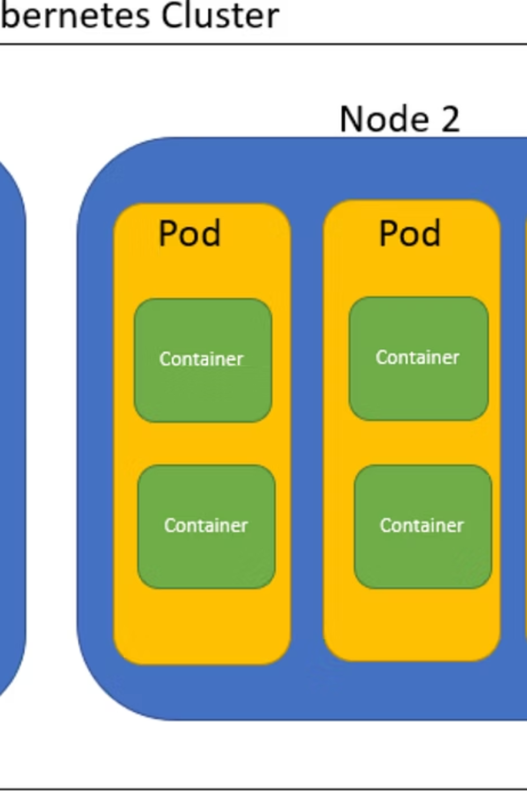
Kubernetes Workload Management
A comprehensive guide to understanding and managing different workload types in Kubernetes, from basic Pods to advanced scheduling strategies.

Slide 2
Learning Goals
1
Understand different workload types in Kubernetes
Explore the various ways to deploy and manage applications in a Kubernetes cluster
2
Learn scaling mechanisms (HPA, VPA)
Master both horizontal and vertical scaling approaches to handle varying workloads
3
Apply resource limits (CPU, Memory)
Implement proper resource management to ensure application stability
4
Explore node scheduling strategies
Control where and how pods are placed across your cluster
5
Practice with Deployments and CronJobs in lab
Get hands-on experience with real-world Kubernetes objects

Slide 3
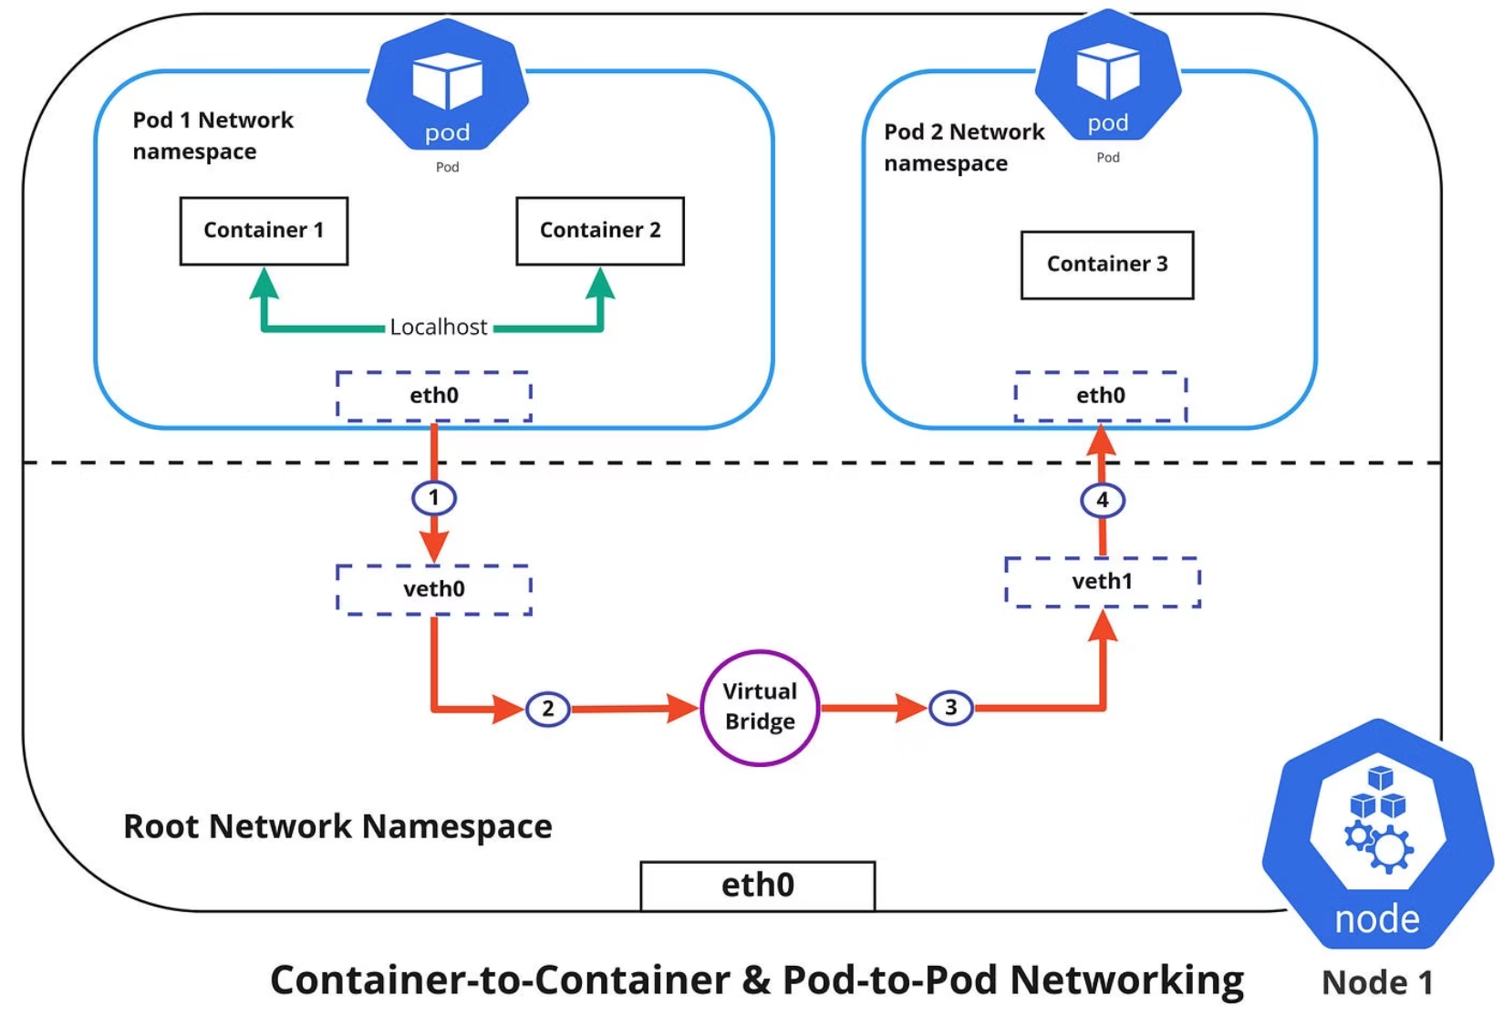
Pods: The Smallest Execution Unit
A Pod is the smallest deployable unit in Kubernetes. Think of Pods as a wrapper around containers. If a Pod fails, Kubernetes creates a new one instead of fixing it.
Key characteristics:
Can contain one or more containers
Containers in a Pod share network (same IP & port space)
Containers in a Pod share storage (shared volumes)
Pods are ephemeral → replaced, not repaired

Slide 4

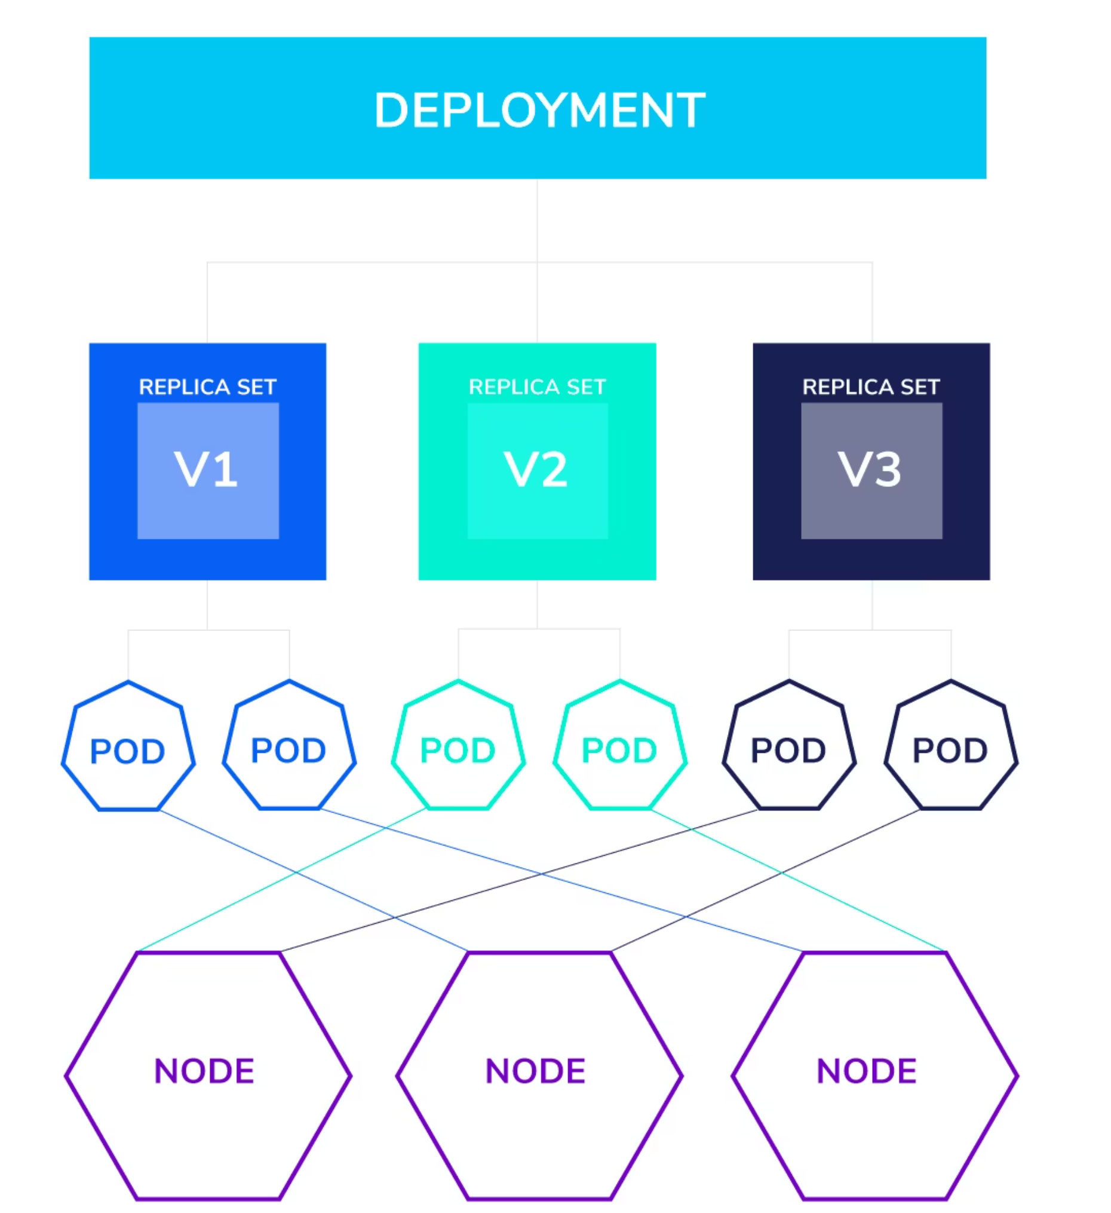
ReplicaSets & Deployments
ReplicaSet
Ensures specified number of pod replicas are running
Replaces failed Pods automatically
Maintains desired state of the system
Deployment
Higher-level controller that manages ReplicaSets
Supports rolling updates and rollback
Most common way to deploy applications
Example command: kubectl scale deployment nginx --replicas=5

Slide 5
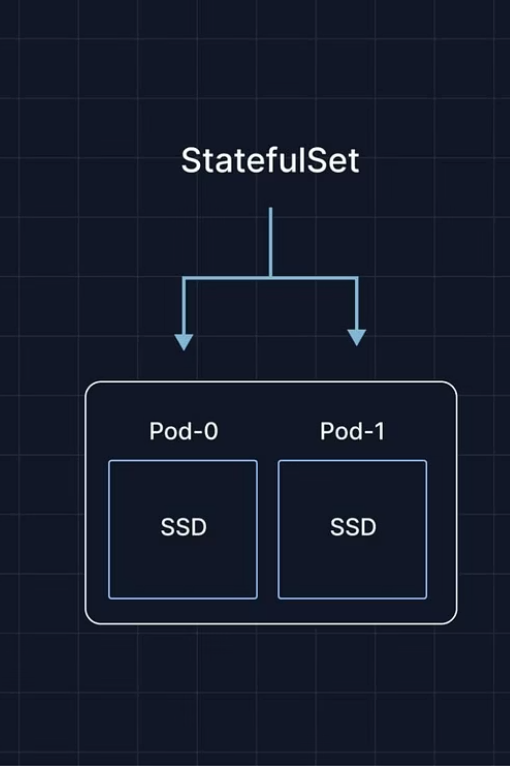
StatefulSets vs DaemonSets
StatefulSets
DaemonSets
Manages stateful applications
Ensures a Pod runs on every (or selected) node
Provides stable network identity and persistent storage
Common for logging, monitoring agents, networking daemons
Example: Databases (MySQL, Cassandra, MongoDB)
Use for node-wide services
Use when order and identity matter

Slide 6
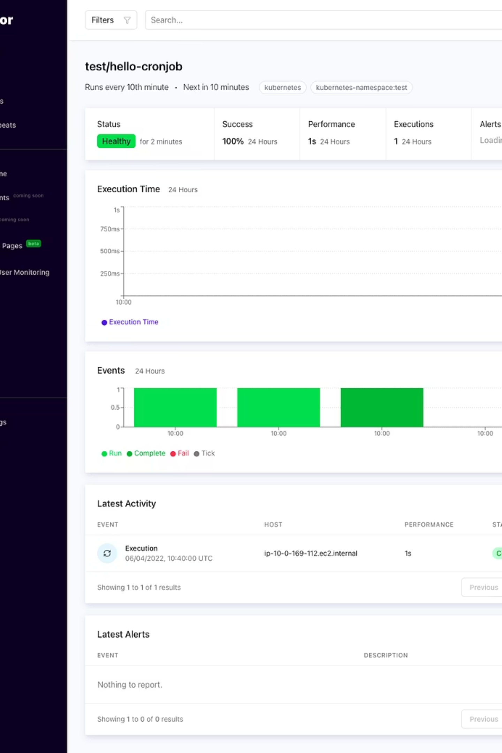



Jobs & CronJobs
Job
Runs a Pod until completion
Example: Batch processing, data migration
CronJob
Runs Jobs on a schedule (like Linux cron)
Example: Backup every night, cleanup tasks
YAML snippet:
schedule: "*/1 * * * *" # every minute

Slide 7
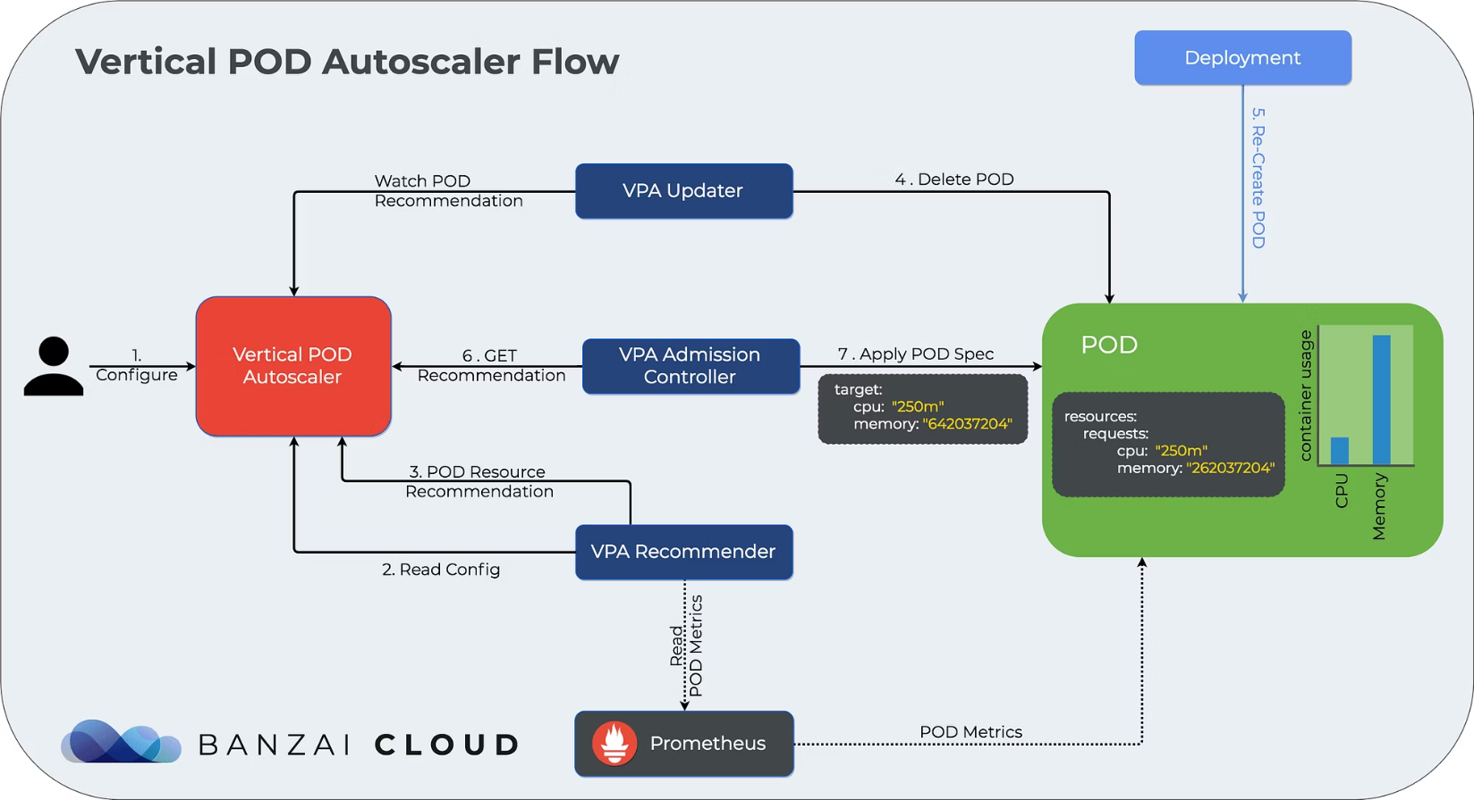
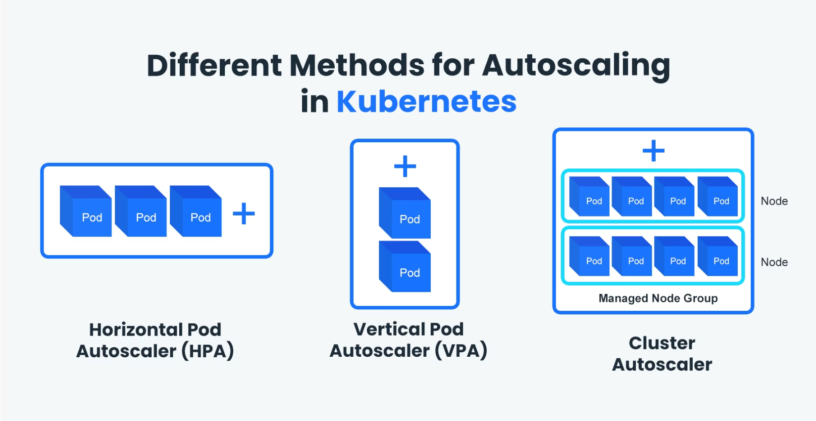
Scaling in Kubernetes
Horizontal Pod Autoscaler (HPA)
Vertical Pod Autoscaler (VPA)
Scales Pods based on CPU/Memory/Custom metrics
Adjusts Pod CPU & memory requests/limits automatically
Example: Add Pods when CPU > 70%
VPA = scale up/down (change resources per Pod)
HPA = scale out/in (more or fewer Pods)

Slide 8
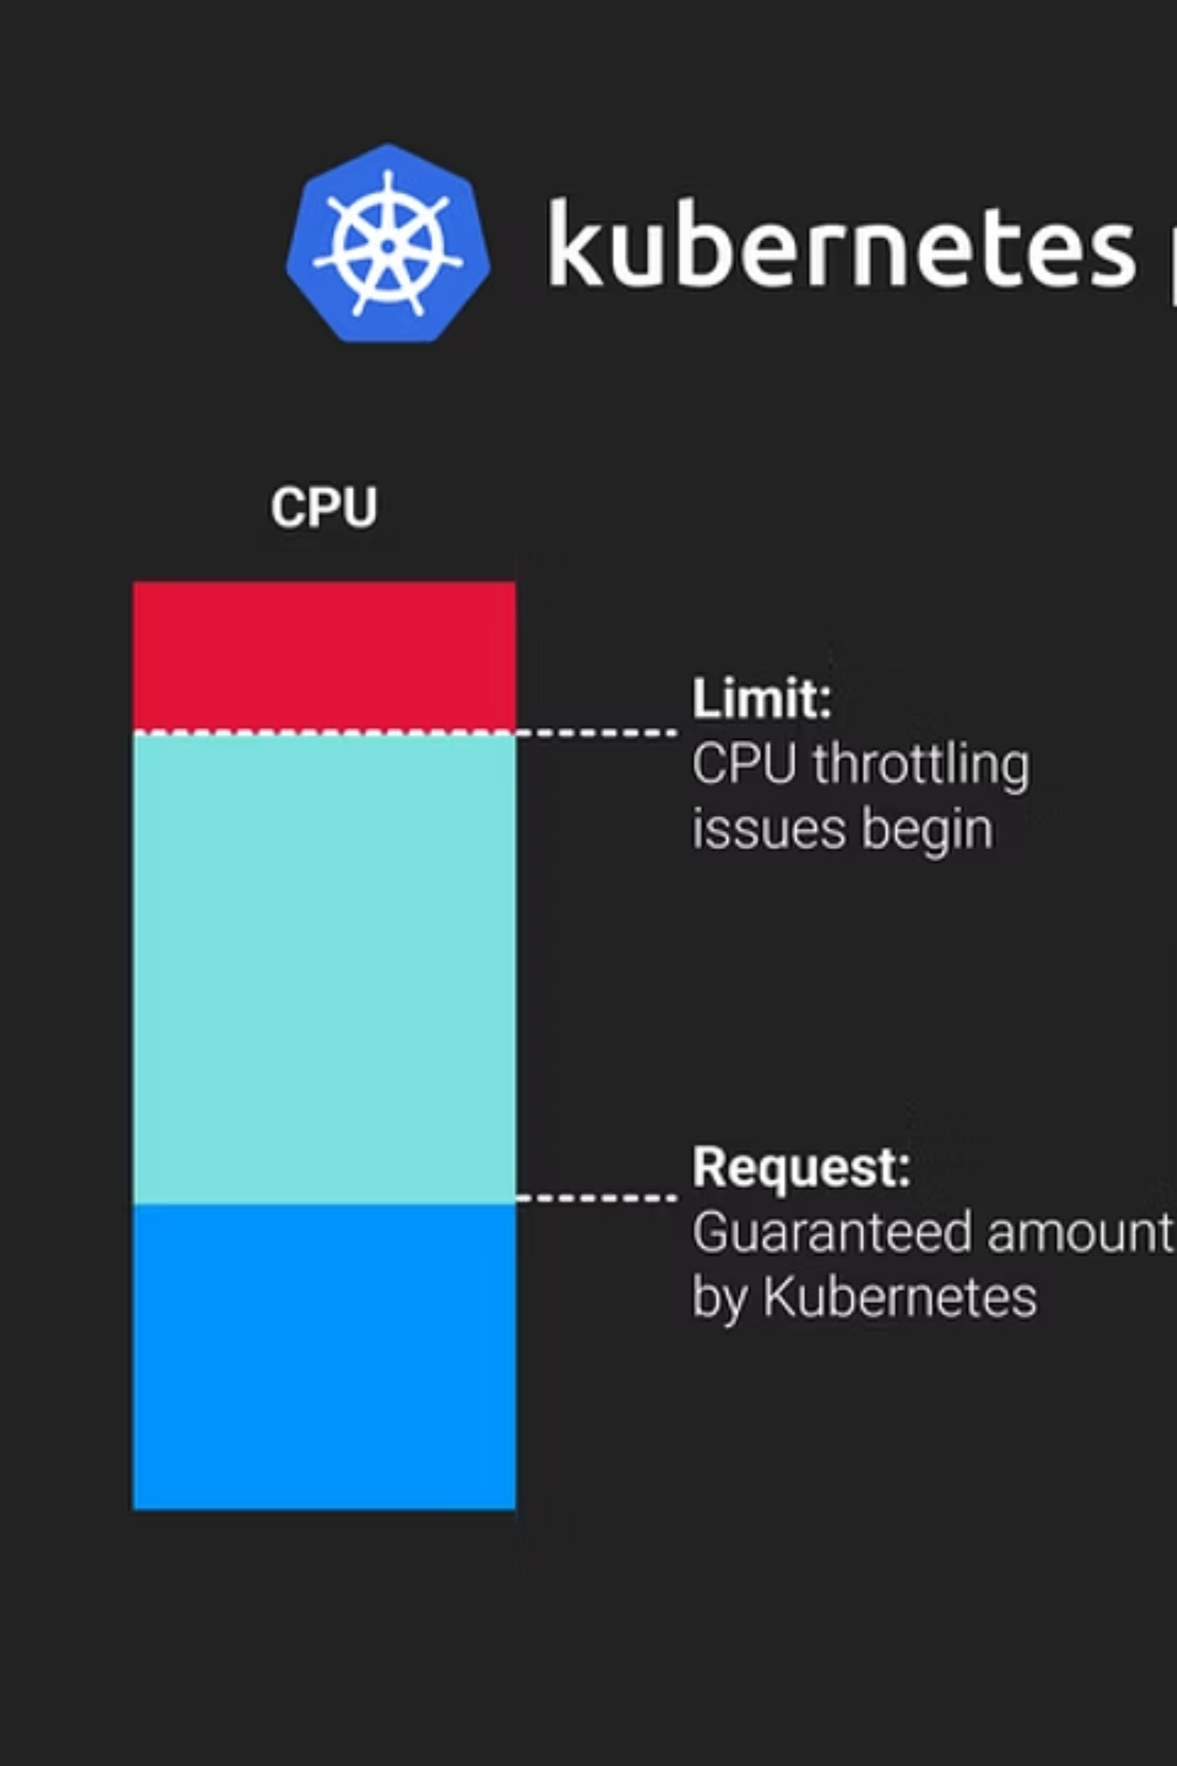
Resource Requests & Limits
Requests
Minimum resources guaranteed to the Pod
Affects scheduling decisions
Limits
Maximum resources allowed for the Pod
Affects runtime throttling/termination
resources: requests: cpu: "250m" memory: "256Mi" limits: cpu: "500m" memory: "512Mi"

Slide 9
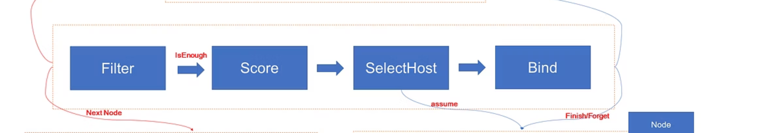
Node Scheduling
Taints & Tolerations
Node Affinity
Pod Affinity/Anti-Affinity
Prevent Pods from running on specific nodes unless tolerated
Prefer or require Pods to run on certain nodes
Control Pod placement relative to other Pods
Examples:
Run monitoring Pods on all nodes → Tolerations + DaemonSet
Run DB Pods only on high-memory nodes → Node Affinity

Slide 10
Lab Exercise (20 min)
Hands-On Tasks
01
02
Create Deployment
Scale Deployment
kubectl create deployment nginx --image=nginx --replicas=3
kubectl scale deployment nginx --replicas=5
03
04
Add Resource Limits
Run a CronJob
Apply via kubectl edit deployment nginx
Create a CronJob that runs every minute
resources: requests: cpu: "200m" memory: "256Mi" limits: cpu: "500m" memory: "512Mi"
Guide participants step by step. Show kubectl get pods after scaling and kubectl get cronjobs to confirm.

